Slide 1
Protecting Your Digital Life

Slide 2
Important Information
This document is for information purposes only. Brio Consultants, LLC is an independent SEC-registered investment adviser. SEC registration does not constitute an endorsement by the SEC nor does it indicate a particular level of skill or ability. Brio Financial Group is an assumed business name of Brio Consultants, LLC. Neither the information nor the opinions expressed herein constitutes an offer or solicitation to buy or sell any investments or to make any investment decision. Please refer to the firm’s form ADV for more information. Past performance is no guarantee of future results, and political and economic risks may lead to significant losses, including complete loss, for investors. Advisory services are only offered to clients or prospective clients where Brio Financial Group and its representatives are properly licensed or exempt from licensure. Hypothetical returns do not factor the advisory fees charged by Brio Financial Group. Actual portfolio(s) may not resemble any of hypothetical allocation examples based on a variety of factors including but not limited to those listed above. Any distribution or copying of this communication is strictly prohibited. No offer to purchase or sell securities is being made in this communication. The information set forth herein was obtained from sources which we believe reliable, but we do not guarantee its accuracy. Overall account performance cannot and should not be extrapolated from any examples or illustrations given. This material is being provided for informational purposes only and nothing herein constitutes investment, legal, accounting or tax advice, or a recommendation to buy, sell, or hold a security. Neither the information nor the opinions expressed herein should be used to make any investment decision. Consultations with CPA’s or Estate Planning Attorneys regarding taxes and issues relating to estates or beneficiaries are recommended. Past performance is no guarantee of future results. For further information about this presentation, please contact us.

Slide 3
Quiz Time!
Data breaches have increased since 2021 by:
12%
72%
Not at all
There were ______ Victims in 2023 impacted by cybersecurity breaches:
24,593
1,789,233
343,338,964
Total losses in 2023 from data breaches was______
12.5 billion
189 million
2.3 billion
The likelihood of you, an individual, being a victim
50%
97%
62%
Notes:
Data breaches: 2,365 in 2023, a 72% increase from 2021
Victims: 343,338,964 in 2023
76% of identity theft victims
Complaints from the U.S. public: 880,418 in 2023, a 10% increase from 2022, totaling $12.5 billion in losses
97% likelihood
And my source for complains is Forbes Advisors, Feb 28 2024, article:
Cybersecurity Stats: Facts And Figures You Should Know

Slide 4
How Do We Protect Our Clients?
Endpoint Security
Secure DNS Filtering
Endpoint Detection and Response (EDR)
24/7 Security Operations Center (SOC) Monitoring
Alles Application Whitelisting
Weekly Patch Management
User Security
Advanced Spam and Virus Filtering
AI-Based Phishing Detection
Strong Email Encryption
Rigorous Cybersecurity Training
Challenging Phishing Simulation Campaigns
Enterprise-Grade Password Management

Slide 5
The First Line of Defense: Your Password
Strong passwords act as a robust barrier against hackers, preventing unauthorized access to your online accounts and personal information.
Use a random mix of uppercase and lowercase letters, numbers, and symbols.
Avoid common words and predictable sequences. Your children’s names, birthdates, and favorite sports teams are not good choices.
Change passwords regularly and never reuse them.
Are you using one or a mix of a couple passwords for everything? Has it changed since 2014?

Slide 6
Simplify Security with Password Managers
Password managers help you generate and store complex passwords, reducing the risk of breach and the stress of remembering multiple passwords.
Consider Dashlane, LastPass, NordPass

Slide 7
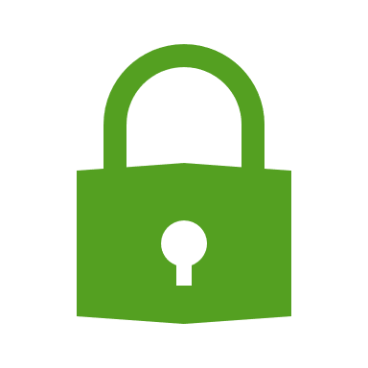
Significantly Improve Protection with Multifactor Authentication (MFA)
MFA enhances security by requiring two or more verification methods to access your accounts, making it harder for attackers to gain unauthorized access.
Multiple layers significantly reduce the risk of account compromise.
Best practice for securing sensitive and important accounts.

Slide 8
Network Security & Virtual Private Networks (VPNs)
While VPNs provide privacy and some level of security by encrypting your internet connection, they do not protect against all types of cyber threats.
Consider what locations VPNs are connecting you to
Be smart about open networks
Consider using your hotspot

Slide 9
Beware of Common Cyber Crimes
Cyber crimes like phishing, malware, and ransomware attacks are prevalent threats that can lead to data loss, financial fraud, and identity theft.
Phishing: The fraudulent practice of sending emails or other messages purporting to be from reputable organizations in attempts to induce individuals to reveal personal information.
Malware: Software specifically designed to disrupt, damage, or gain unauthorized access to a computer system.
Ransomware: Malicious software designed to block access to systems and data to then demand payment to restore access.

Slide 10
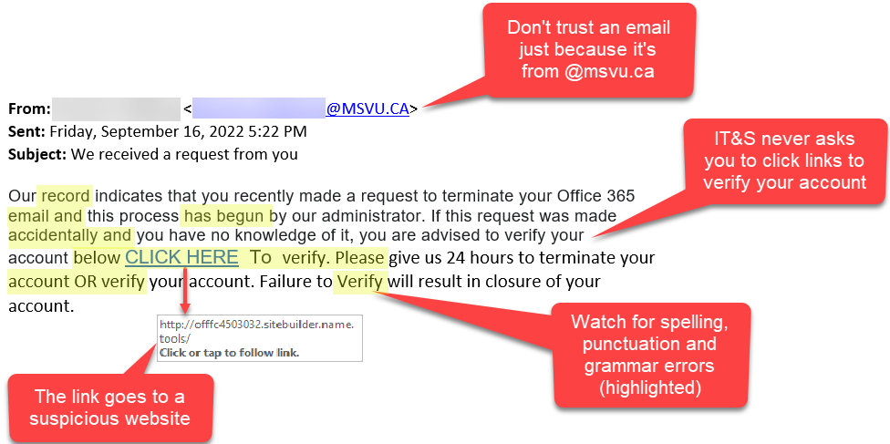
How to Spot Common Phishing Messages
Requests for personal information
Generic greetings or lack of greetings
Misspellings
Unofficial “from” email addresses
Unfamiliar webpages
Misleading Hyperlinks
Threats or sense of urgency
Inappropriate language or tone
Most impersonated brands - Google,
Amazon, and What’sApp

Slide 11
Is It Phishing?

Slide 12
Is It Phishing?

Slide 13
Is It Phishing?

Slide 14
Staying Safe Online
Adopting good cybersecurity habits can significantly reduce the risk of falling victim to cyber crimes.
Verify the source before clicking on links or downloading files.
Use security software and keep it updated.
Regularly backup important data.

Slide 15
How BRIO Works to Protect YOU
Hiring a competent IT partner with solid expertise in Cybersecurity
Annual required training of all Brio team members.
Doing spoof email spams to staff to identify additional internal training needs.
Cybersecurity audits and monthly review of Cybersecurity reporting.
Documented Cybersecurity policies and procedures as required by regulatory agencies.
Verbal verification of money movement requests for outside unknown accounts.

Slide 16
Help Mitigate Check Fraud
1 | Consider signing up for the free Informed Delivery service, which the post office uses to send you electronic previews of upcoming mail.
2 | Whenever possible, use an electronic payment method instead of a paper check (e.g. ACH (Schwab MoneyLink®), bill pay, or if needed, a wire).
3 | If you’re expecting a check for a large dollar amount, request a direct deposit into your checking account instead of a physical check in the mail.
4 | Remember that bringing your mail to the post office is more secure than dropping it in a collection box. If you must use a box, drop it in prior to the final scheduled pickup—criminals tend to target mail that sits in collection boxes overnight.
5 | Monitor your accounts online and review all check images to ensure they were deposited.
6 | Use pens with indelible black ink so it is more difficult for fraudsters to remove and replace your writing and change the dollar amount on checks.
7 | Follow up with charities and other businesses to make sure they received your check.
8 | Consider the risk before adding checking features linked to your brokerage account.
9 | Report any fraud and/or suspicious activity to your advisor and Schwab immediately.
10 | Shred cashed checks.

Slide 17
Thank You
We appreciate your time and attention to this important topic. Now, we would love to hear from you. Any questions or areas you would like to further explore?

