Slide 1

Making Connections

Slide 2

Important Information
This document is for information purposes only. Brio Consultants, LLC is an independent SEC-registered investment adviser. SEC registration does not constitute an endorsement by the SEC nor does it indicate a particular level of skill or ability. Brio Financial Group is an assumed business name of Brio Consultants, LLC. Neither the information nor the opinions expressed herein constitutes an offer or solicitation to buy or sell any investments or to make any investment decision. Please refer to the firm’s form ADV for more information. Past performance is no guarantee of future results, and political and economic risks may lead to significant losses, including complete loss, for investors. Advisory services are only offered to clients or prospective clients where Brio Financial Group and its representatives are properly licensed or exempt from licensure. Hypothetical returns do not factor the advisory fees charged by Brio Financial Group. Actual portfolio(s) may not resemble any of hypothetical allocation examples based on a variety of factors including but not limited to those listed above. Any distribution or copying of this communication is strictly prohibited. No offer to purchase or sell securities is being made in this communication. The information set forth herein was obtained from sources which we believe reliable, but we do not guarantee its accuracy. Overall account performance cannot and should not be extrapolated from any examples or illustrations given. This material is being provided for informational purposes only and nothing herein constitutes investment, legal, accounting or tax advice, or a recommendation to buy, sell, or hold a security. Neither the information nor the opinions expressed herein should be used to make any investment decision. Consultations with CPA’s or Estate Planning Attorneys regarding taxes and issues relating to estates or beneficiaries are recommended. Past performance is no guarantee of future results. For further information about this presentation, please contact us. *Services are offered through Wealth, an independent third party service provider. Brio is not affiliated with Wealth and does not provide legal services​

Slide 3
How to Navigate Relationships Post COVID
Special Guest: Peter Gandolfo Executive Coach
What’s changed?
Fostering existing relationships
Building new relationships
Networking in this new normal

Slide 4
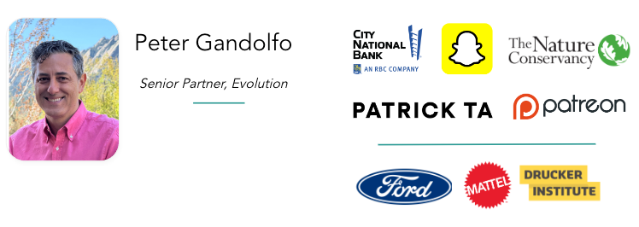
Meet Peter!

Slide 5
Check In!
Name and Location
A recent energizing in person social interaction is…
How many in-person social interactions do you have on average each week?

Slide 6
What Changed?
We are Connecting Less and Less
● The U.S. was originally celebrated for extroversion: political associations, labor unions, local memberships.
● Declined after the 1970s: houses of worship, bowling leagues, book clubs…
● In last 20 years, percentage who volunteer or attend church declined 30%
● Reduced hours of face-to-face socializing (2003-2022)
  ○ American men: -30%
  ○ Unmarried Americans: -35%
  ○ Teenagers: >-45%
Source: The Atlantic: Why Americans Suddenly Stopped Hanging Out, Derek Thompson

Slide 7

Solitude Emerged Even Pre-Pandemic
Unprecedented solitude, anxiety, dissatisfaction, and depression about the direction of the country in 2020s
● In 2023, NBC pollsters reported highest level of sustained pessimism in 30+ history of the poll
● Trends predate pandemic; accelerated after 2015
● More time with pets: 2x over 20 years
Source: The Atlantic: Why Americans Suddenly Stopped Hanging Out, Derek Thompson

Slide 8

How’d This Happen?
● More time with screens
● Everyone is so busy and spread out
● Decline in community
Source: The Atlantic: Why Americans Suddenly Stopped Hanging Out, Derek Thompson

Slide 9
Is Loneliness an Epidemic?
The Surgeon General thinks so and loneliness has been described as such in many parts of the world. Relationships are key to our health.
Loneliness is pervasive across different age groups and demographics. While it's often associated with the elderly, it affects people of all ages, including teenagers, young adults, and middle-aged individuals.
Chronic loneliness has been linked to increased risk of depression, anxiety, substance abuse, cardiovascular diseases, weakened immune system, and even premature death.
An 80-year-long Harvard study published in 2017 revealed that close relationships, more than money, fame or genes, are what keep people happy throughout their lives, helping to delay mental and physical decline.

Slide 10
How to Navigate Relationships Post COVID
What's become clear is that our relationships are experiencing a profound reset. Across generations, having faced a stark new reality, a decades-long trend¹ reversed as people are now shifting their energy away from maintaining a wide array of casual connections to cultivating a smaller circle of the people who matter most. In fact, 72%² of people surveyed in August 2021 said that the pandemic caused them to reprioritize their closest friends.

Slide 11
What’s Worked for you Post-Pandemic?

Slide 12
Active Friendship
Sometimes it's not that you don't have friends, it's that you need to experience friendship - create experiences you can enjoy together and savor experiences you've had together.
How Deepen Relationships
Schedule regular check-ins
Be clear and transparent in your communication
Express gratitude and appreciation
Follow through on commitments
Respect boundaries and preferences
Build trust through consistent actions
Shared Activities and Hobbies
Find common interests
Explore new activities together
Foster a sense of collaboration and teamwork
Create memorable experiences

Slide 13

Invest in Quality Time
Make time for meaningful interactions
Prioritize face-to-face meetings when possible
Create rituals and traditions
Value the quality of time spent together

Slide 14
Finding New Peeps
What do you do when you meet someone new who you want to get to know better?

Slide 15
Thought Starters
● Communities based on shared interest or new hobby
  ○ Running, hiking clubs; knitting, pottery classes
  ○ Eventbrite, Meetup, facebook groups
  ○ TimeLeft.com
  ○ Bumble for Friends
● Identity-driven networking events like Out for Business, Alumni Club networking, Chief, Coaching Circles, UCLA Dinner for 12 Strangers
● Volunteering
● Co-working days
Notes:
Dog mom
Community builder
Volunteer
Mentor
Crafter
Earner

Slide 16
What if I’m an Intovert?
● Consider smaller group events
● Invite a friend
● Redefine success: quality over quantity
● Take care of yourself
  Before: come in with a full battery
  During: take a break
  After: Leave when you are “full”; plan recharging activities

Slide 17
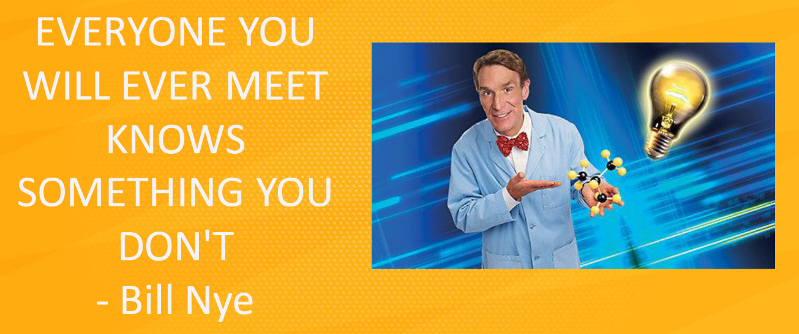

Slide 18
Let’s Talk About Small Talk
First, be curious. The person or people you're talking to are interesting. Chances are, they know a whole lot about something you know something about — if not many things. Take advantage of that. Figure out what they care about and ask lots of questions. Don't forget to listen and stay engaged so it's clear you're not just going through the motions.
Second, pose unique questions and start non-obvious discussions. If you say something like, "It's so cold this week," you're going to have a meh conversation (unless you're talking to a farmer or meteorologist, maybe). Get creative and maybe a little weird. When someone says, "Wow, it's so cold this week," reply, "Sure is. Did you grow up in a warmer area?" Now you're talking about their childhood and the different places they've lived. Way more interesting.

Slide 19
How to Make Small Talk
Ask open-ended questions.
Most people enjoy talking about themselves because it's easier to discuss things we know to be true (our likes, dislikes, and aspirations) rather than something we know little about. Open-ended questions generate an interesting, dynamic conversation and encourage the person you’re speaking with to open up.
Practice active listening.
You’ll forge much stronger connections if you pay attention. The other person will notice how engaged you seem. In addition, it’s much easier to ask relevant questions and remember details to bring up later if you’re listening with both ears.
Make eye contact and put away your phone.
It’s overwhelming to hold eye contact the entire time you’re talking to someone, but ensuring you meet their eyes helps show you’re listening. Few people will approach you if you’re scrolling through your phone—and you’ll send a plain message to anyone you’re already talking to that you’re not interested.
Show your enthusiasm.
Small talk might not always be the most stress-free activity. However, if you go into it with the right attitude, you can actually have fun. View these conversations as opportunities to learn more about other people. You never know whom you’ll meet or what they’ll have to share—so embrace the chance it’ll be an amazing discussion.

Slide 20
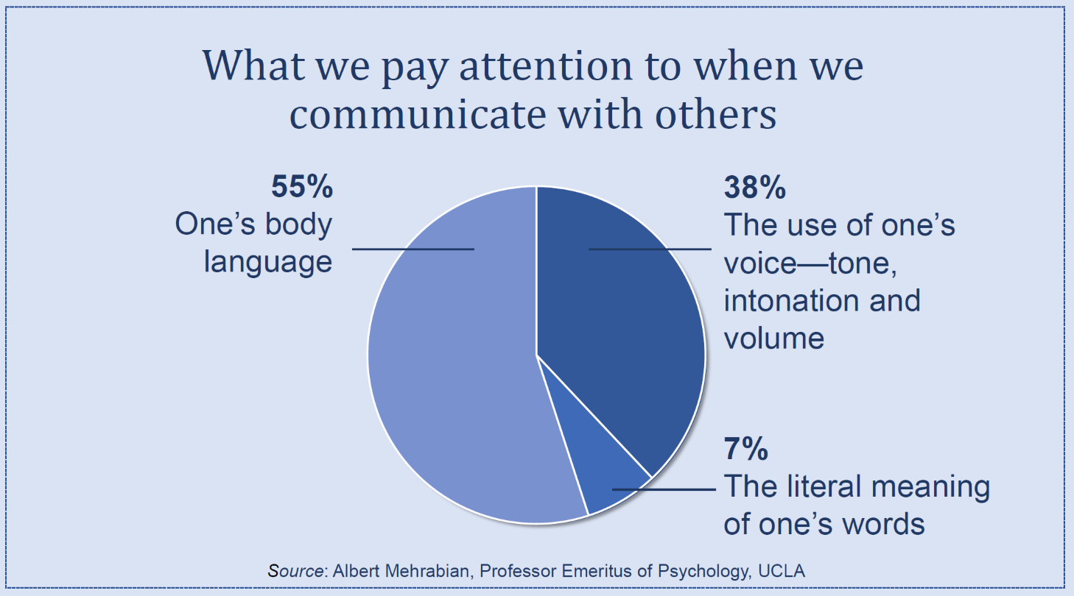
Where’s the most effective
place to stand for connection?
Interested > Interesting

Slide 21
Have a Few Good Questions
● What are you drinking?
● What brings you here?
● What’s your favorite restaurant in this part of town?
● What other events have you been to recently that you enjoyed?
● What are you looking forward to this month/season?
● What music are you listening to right now?
We have a bunch more resources on small talk and sample questions just ask for the deck after today’s session!

Slide 22
Resources
This TikTok highlights maintaining friendships. https://www.tiktok.com/@missmoneypenny413/video/7348941745700261162?_r=1&_t=8ku9ulU6TtO
Book: Your Invisible Network by Michael Melcher
Podcast: The Five Levels of Listening by Oscar Trimboli

Slide 23
Networking 101
Connecting with peers with similar hobbies and interests can also help you build your professional network. You never know: that friend you meet at a pottery class may have a sibling who works in your field and wants to connect.
Proactively make connections between contacts who you feel should meet. If you’re at a conference and you’ve met two people at a mixer who seem like they’d have a lot to talk about, connect them! When introducing two people, lead with interesting details you’ve learned about them. Instead of “John, meet Paavan. Paavan, meet John,” try “John, this is Paavan, he just launched a YouTube channel for emerging musicians. John is a synth and keyboard collector.”
Learn to gracefully exit a conversation. There will always be a conversation or two that you’ll feel the need to move on from. When there’s a lull, try saying “Well, do let me know how [project they mentioned] goes, I’d love to hear how it turns out. It was great to meet you!”

Slide 24
The Business of Business
Collaborative Partnerships
Identify complementary businesses and organizations.
Establish mutually beneficial partnerships including referrals and new business
Leverage each other's strengths and resources for problem-solving and innovation
Foster a spirit of collaboration and teamwork.
Maintaining Relationships
Center trust, communication, and mutual benefit.
Regular follow-ups and check-ins.
Seek feedback and input. Address issues promptly and effectively.
Celebrate milestones and successes.

Slide 25
Check Out!
What is your biggest takeaway from today?

Slide 26
Resources

Slide 27

Close Relationships
Primarily connected to a feeling of greater closeness with others
Characterized by broadly meaningful relationships that are typically long in duration, high in quality and/or low in quantity
Often formed with partners, family, close friends

Slide 28

Primary Factors for Relationship Prioritization
Physical Proximity
Personal Values
Common Interests
Ability to Create New Memories
Meaningful Prior Memories

Slide 29
Be Flexible
Be open to change and adjustment
The dawn of new collective memory creation “The end of Blursday”—the blurring of time due to fewer distinct markers, such as differing locations, conditions, etc.—may drive new experience creation.
Recognize individual needs and preferences
Adapt communication styles as needed
Embrace flexibility in plans and arrangements

Slide 30
Combating Loneliness
Reclaim time with one another. Make plans.
Be vulnerable, ask for help, offer help, the fundamental source of healing is togetherness
Be present. Make that call, write that card, send that email. Presence is noticed while absence is missed.
Envision a people-centered life. Eliminate detractors. Evaluate do you have enough people in your life that are "energy adds"?
Engaging in service may contribute to a decrease in feelings of loneliness and isolation.
Center love and ask what does love do for you, for your loved ones. How can you capitalize on that.

Slide 31
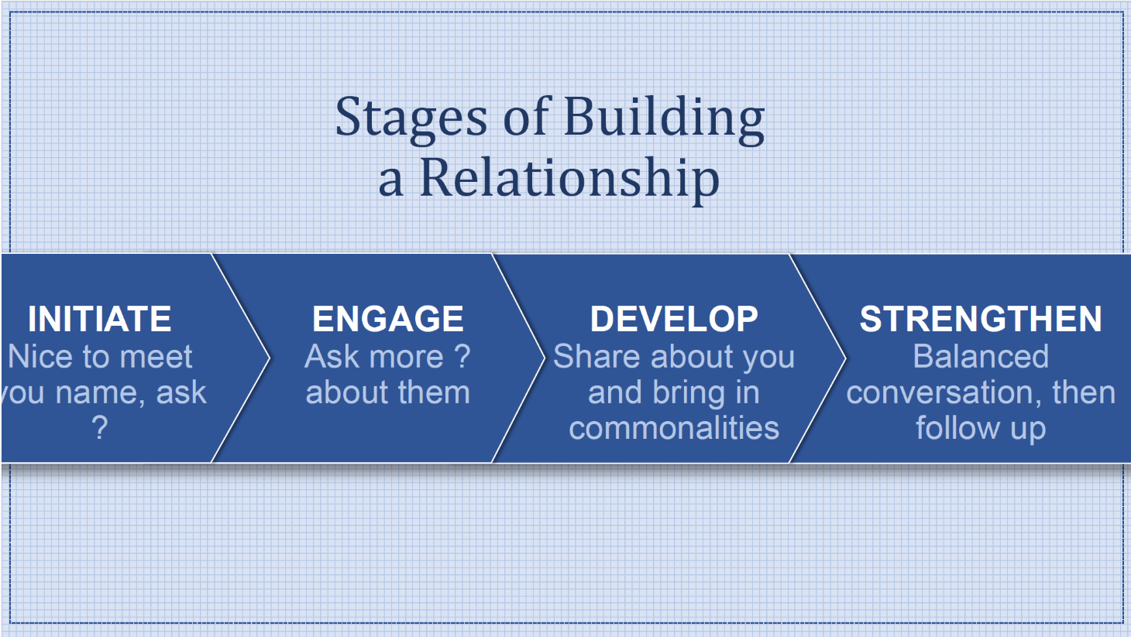
Notes:
Dog mom
Community builder
Volunteer
Mentor
Crafter
Earner

Slide 32
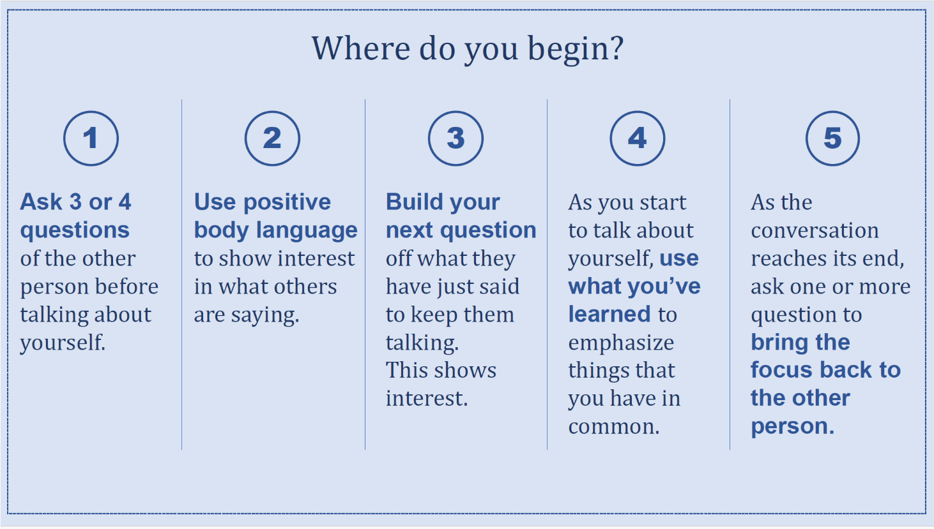
Notes:
Dog mom
Community builder
Volunteer
Mentor
Crafter
Earner

Slide 34
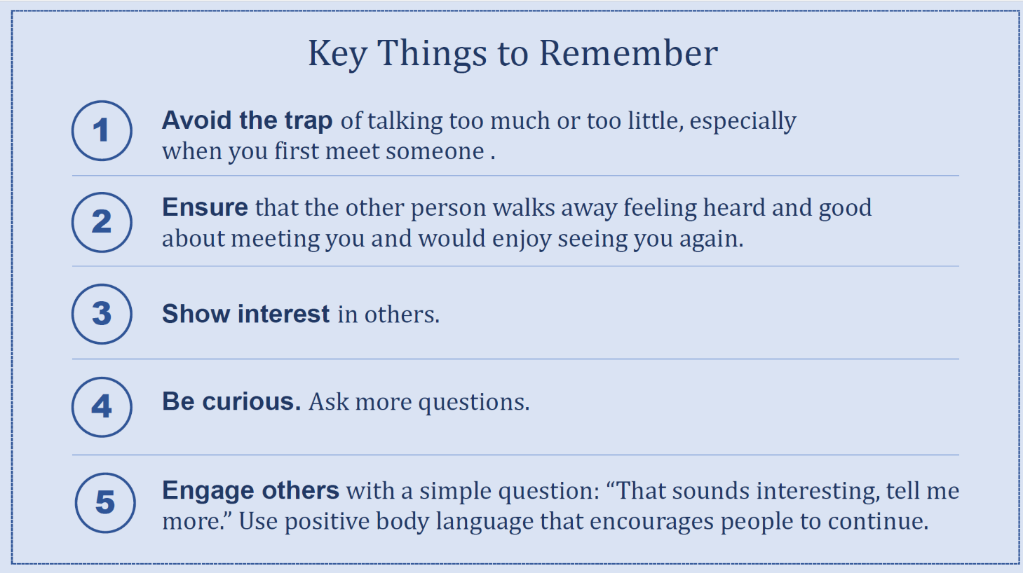

Slide 35
What To Talk About?
Local Area
Entertainment
Art
Restaurants
Hobbies
Work
Sports
The Weather
Travel
Local Attractions
Pretend you are talking to a friend
DON’T talk about
Politics
Physical Appearance
Religion
Age
Anything PG-13+

Slide 36

Getting Better
Set a goal
Practice
Do what you said you would do
Pay it forward
You can practice in a low-stakes environment. Go to a casual networking event for a different industry, attend a meetup, or ask your friends to bring you along to their work events.

Slide 37
Making a Graceful Exit
“This has been great — thanks for telling me about X. Do you have a card?”
“Can’t wait to hear how [initiative, project, personal decision] goes! Let’s catch up at the next [work party, conference, meeting, get-together].”
“I’m going to go grab [some food, a drink]. Great to [meet you, catch up].”
“I see my [friend, coworker, client] over there and should probably go say hi. Want to exchange contact info?”
“The next session is starting soon, so I’m going to go find my room. It was nice meeting you!”
“Excuse me, I’m going to use the restroom. Enjoy the rest of the [event, party, conference].”
“Well, glad we got the chance to connect over [topic]. I don’t want to dominate your [morning, afternoon, night] — I’m going to [check out the snacks, say hello to someone, take a walk around the venue, etc.]”
“Is there anything I can [help you with, do for you]?”
These exit lines can help you move along and grab contact info

Slide 38
Examples of Building Biz Rapport Questions
“What’s the most exciting thing about your [business/product/team/industry]?”
“What’s the most significant change at your company in the past six months?”
“If you could go back one year in time, what would you do differently?”
“I’m curious to know your story.”
“Tell me about your highlights at [company name].” or “Tell me about your lowlights at [company name].”
“What’s your biggest priority right now?”
“What is your boss fixated on right now?”
“What’s your number one most important metric?”
“What can I do to help you achieve [X goal]?”

Slide 39
Examples of Questions for Biz Clients
“How are things going?”
“What’s your progress on [X goal]?”
“How has business changed since we talked last?”
“What are you worried about?”
“What are you happy about?”
“Which industry events are you planning on attending?”
“How are your efforts in [related business area]?”
“How’s life in [city]?”
“What can I do to make you even more successful?”

Slide 40
Examples of Building Biz Rapport Questions
“What’s your industry like right now?”
“Do you need any introductions?”
“As an expert in [field], I’d love to hear your thoughts on [event, announcement, major change].”
“Tell me about your latest work win.”
“We’ve discussed your role before, but it’s probably evolved since then.”
“Which blogs are you reading to stay informed on [topic]?”
“You’re still one of the only people I know who [did X, achieved Y].”

Slide 41
Examples of Questions if at an Event
“How did you end up at [name of event]? If you could snap your fingers to instantly summon your [coworker, boss, best friend], would you? Why or why not?”
“What’s been the highlight of your [day, week, month] so far?”
“Would you recommend that [food or drink they’re holding]?”
“If this was Groundhog Day and you had to repeat this day over and over, would you be relatively happy or unhappy about this particular day?”
“What was the last concert you went to? How was it?”
“How did you choose to work in [field]? If you could go back in time, would you make that same choice again?”
“If you could turn one of your current skills into a bona fide superpower, which would it be and why?”
“Which TV show would you choose to live in?”
“When was the last time you did something for the first time? Were you glad you tried it?”
“If you were hosting this event, [who would you invite to speak, which theme would you have chosen, what would you have done differently]”

Slide 42
Important Information
This document is for information purposes only. Brio Consultants, LLC is an independent SEC-registered investment adviser. SEC registration does not constitute an endorsement by the SEC nor does it indicate a particular level of skill or ability. Brio Financial Group is an assumed business name of Brio Consultants, LLC. Neither the information nor the opinions expressed herein constitutes an offer or solicitation to buy or sell any investments or to make any investment decision. Please refer to the firm’s form ADV for more information. Past performance is no guarantee of future results, and political and economic risks may lead to significant losses, including complete loss, for investors. Advisory services are only offered to clients or prospective clients where Brio Financial Group and its representatives are properly licensed or exempt from licensure. Hypothetical returns do not factor the advisory fees charged by Brio Financial Group. Actual portfolio(s) may not resemble any of hypothetical allocation examples based on a variety of factors including but not limited to those listed above. Any distribution or copying of this communication is strictly prohibited. No offer to purchase or sell securities is being made in this communication. The information set forth herein was obtained from sources which we believe reliable, but we do not guarantee its accuracy. Overall account performance cannot and should not be extrapolated from any examples or illustrations given. This material is being provided for informational purposes only and nothing herein constitutes investment, legal, accounting or tax advice, or a recommendation to buy, sell, or hold a security. Neither the information nor the opinions expressed herein should be used to make any investment decision. Consultations with CPA’s or Estate Planning Attorneys regarding taxes and issues relating to estates or beneficiaries are recommended. Past performance is no guarantee of future results. For further information about this presentation, please contact us. *Services are offered through Wealth, an independent third party service provider. Brio is not affiliated with Wealth and does not provide legal services​

