Slide 1
Smarter you series: Retirement Income Planning
Presented by: Gene Elliott RICP®
Notes:
Good afternoon. My name is Gene Elliott. I am a financial advisor at Brio Financial Group. I am joined today by Pamela Schmitz, another advisor at Brio Financial Group and our Medicare Specialist.
Thank you for taking the time today to join us for our Smarter Your Series – Retirement Income Planning.
Before we begin today, I want to take a moment to go over a few housekeeping items:
We will speak for approximately 40 minutes, after which we will have a question and answer session.
At this time, all lines are muted. If you have any questions during the call, please email me at gene@briofg.com. That’s G-E-N-E @briofg.com. We will try to answer as many questions as we can today. If we are unable to get to your questions, we will follow up with you shortly to get your questions answered.
We will also be recording today’s call and uploading it on our website and Facebook page once approved by compliance.
Lastly, before we begin, as a disclosure, we cannot provide individual recommendations on this call – the topics discussed are intended to be informational only. Please consult with your financial planner, or one of our financial planners at Brio Financial Group, on questions specific to your situation.
With that, let’s get started.

Slide 2
Important Information
This document is for information purposes only. Brio Consultants, LLC is an independent SEC-registered investment adviser. SEC registration does not constitute an endorsement by the SEC nor does it indicate a particular level of skill or ability. Brio Financial Group is an assumed business name of Brio Consultants, LLC. Neither the information nor the opinions expressed herein constitutes an offer or solicitation to buy or sell any investments or to make any investment decision. Please refer to the firm’s form ADV for more information. Past performance is no guarantee of future results, and political and economic risks may lead to significant losses, including complete loss, for investors. Advisory services are only offered to clients or prospective clients where Brio Financial Group and its representatives are properly licensed or exempt from licensure. Hypothetical returns do not factor the advisory fees charged by Brio Financial Group. Actual portfolio(s) may not resemble any of hypothetical allocation examples based on a variety of factors including but not limited to those listed above. Any distribution or copying of this communication is strictly prohibited. No offer to purchase or sell securities is being made in this communication. The information set forth herein was obtained from sources which we believe reliable, but we do not guarantee its accuracy. Overall account performance cannot and should not be extrapolated from any examples or illustrations given. This material is being provided for informational purposes only and nothing herein constitutes investment, legal, accounting or tax advice, or a recommendation to buy, sell, or hold a security. Neither the information nor the opinions expressed herein should be used to make any investment decision. Consultations with CPA’s or Estate Planning Attorneys regarding taxes and issues relating to estates or beneficiaries are recommended. Past performance is no guarantee of future results. For further information about this presentation, please contact us.

Slide 3
Today’s Agenda
Retirement Income Sources
Social Security Claiming Strategies
Pensions
Retirement Accounts and Retirement Income Cash Flow
Taxes & Medicare
Call to Action
Notes:
During today’s session we’ll be covering several topics, starting off with Retirement Income Sources.
We’ll do a deep dive into each of those, including Social Security, Employer Pensions, and Retirement Account withdrawals
We’ll also cover how all of those can impact your taxes and Medicare premiums
And then finally, we’ll talk about a few estate planning best practices that everyone should be keeping top of mind as they prepare for retirement

Slide 4
Life’s Become More Complicated
Years ago, many retirees lived comfortably on their:
Pensions
Social Security Benefits
Whatever else they managed to save
Companies have largely shifted from pensions to 401(k) and similar plans.
Shifts certain risks to employees
May increase the number of critical decisions retirees must take

Slide 5
Retirement Income Sources
Social Security
Pensions
Retirement Accounts
Taxable Accounts/Savings
Working
Notes:
When we think about retirement income sources, there are primarily four types which we will discuss
The first source of income for most people is social security, which will pay you a certain amount each month once you start claiming it
Secondly, we’ll talk about pensions – which primarily apply to public sector employees, but some private sectors as well
Next, we’ll review retirement accounts such as your 401ks, 403bs, IRAs, Roths, and so on
Lastly, we consider your taxable accounts – which include your cash savings, stock investments, and standard brokerage accounts

Slide 6
Pensions
A pension can be a great way to receive guaranteed income, but should you take it as monthly income or a lump sum?
Cost of Living Adjustments – Many pensions don’t have them. Make sure you understand yours before you decide to take a monthly payout instead of a lump sum.
Windfall Elimination Provision – Will your pension reduce or eliminate your Social Security benefits?
Survivor Benefits – it’s always important to consider your spouse when making decisions regarding your pension.
Advanced Techniques – Permanent Life Insurance may be a way to take a life only pension and provide for your spouse in the event of early death.
Notes:
Like I said earlier, pensions are a primary income source for many retirees, but it is also important to note with many pension plans, you don’t have to choose the monthly income stream.
Depending on a variety of factors, like the lump sum value, cost of living adjustments, embedded growth rate, and life expectancy, we can run some calculations on what makes the most sense for you and your family. Its also important to consider the windfall elimination provision that Gene mentioned and whether or not the pension includes healthcare benefits when making that decision
If you do decide on the monthly income stream, there are generally several options you can pick from. Some of which will include spousal benefits if you pass away before them. Sometimes it make sense to not choose an option with spousal benefits as it will reduce your monthly payout while you’re living, but it really just depends on your entire financial situation.
There are also some more advanced techniques we might consider to protect you and your spouse, like permanent life insurance policies. Use the difference in single life with joint life to buy whole life insurance. Start in 50s.

Slide 7
Retirement Accounts
Work Retirement Plans – 401(k), 403(b), 457, Deferred Compensation, Defined Benefit/Pension
Self-Employed Retirement Plans – 401(k), SEP IRA, SIMPLE IRA, Defined Benefit
Individual Retirement Accounts – IRAs & Roth IRAs
Annuities – Are they right for you?
Fixed, Variable or Index – Which one to choose?
Phases – Accumulation & Annuitization
Cost vs Benefits – Understand what you’re paying!
Consolidation & Rollovers – Making the management of your resources easier for you!
Keep Getting Paid – Allow Brio to help you keep your paychecks coming!
Notes:
The other primary retirement income source for many of our clients over age 59 ½ is their retirement savings accounts.
There are a lot of different types of these accounts, depending on if you were a W2 employee, self employed, or were saving on your own in an individual account. 401k, 403b, SEP IRA, Traditional IRA, Roth IRA, and the list goes on.
There’s a big list of these account types, but in general they narrow down to two different kinds: pre-tax (Traditional) or post-tax (Roth). When you’re saving to these accounts, Traditional contributions are tax deductible, while Roth contributions are not. In retirement, Traditional withdrawals are going to be taxed as income, while Roth withdrawals are not taxable at all. So it can make a big difference in determining your total income. Its very important to work with a financial planner when determining which type of account you’re saving to during your working years, so you can be tax efficient in retirement.
Some people might also have also invested in an annuity with some of their savings. There are multiple different types that we won’t get into completely right now, but in general they are another retirement savings vehicle you can use to grow your assets. One of the primary benefits to them is you can use them to create an income stream in retirement just like a pension. These are complex products that can have pretty high fees, so its important to work with an advisor to decide if they make sense for you and what the best type might be.
Another important decision you’ll face in retirement is how to manage your accounts. Its not uncommon these days for clients to have multiple different retirement accounts scattered among various institutions because they’ve had multiple employers over the years. It can be very hard to manage multiple accounts across multiple platforms, so we generally recommend to consolidate them at as few institutions and accounts as possible. Consolidation also helps the people you’re leaving money when you pass away, so everything is in one place for them. Fortunately this can be done without any tax consequences due to the rollover process.

Slide 8
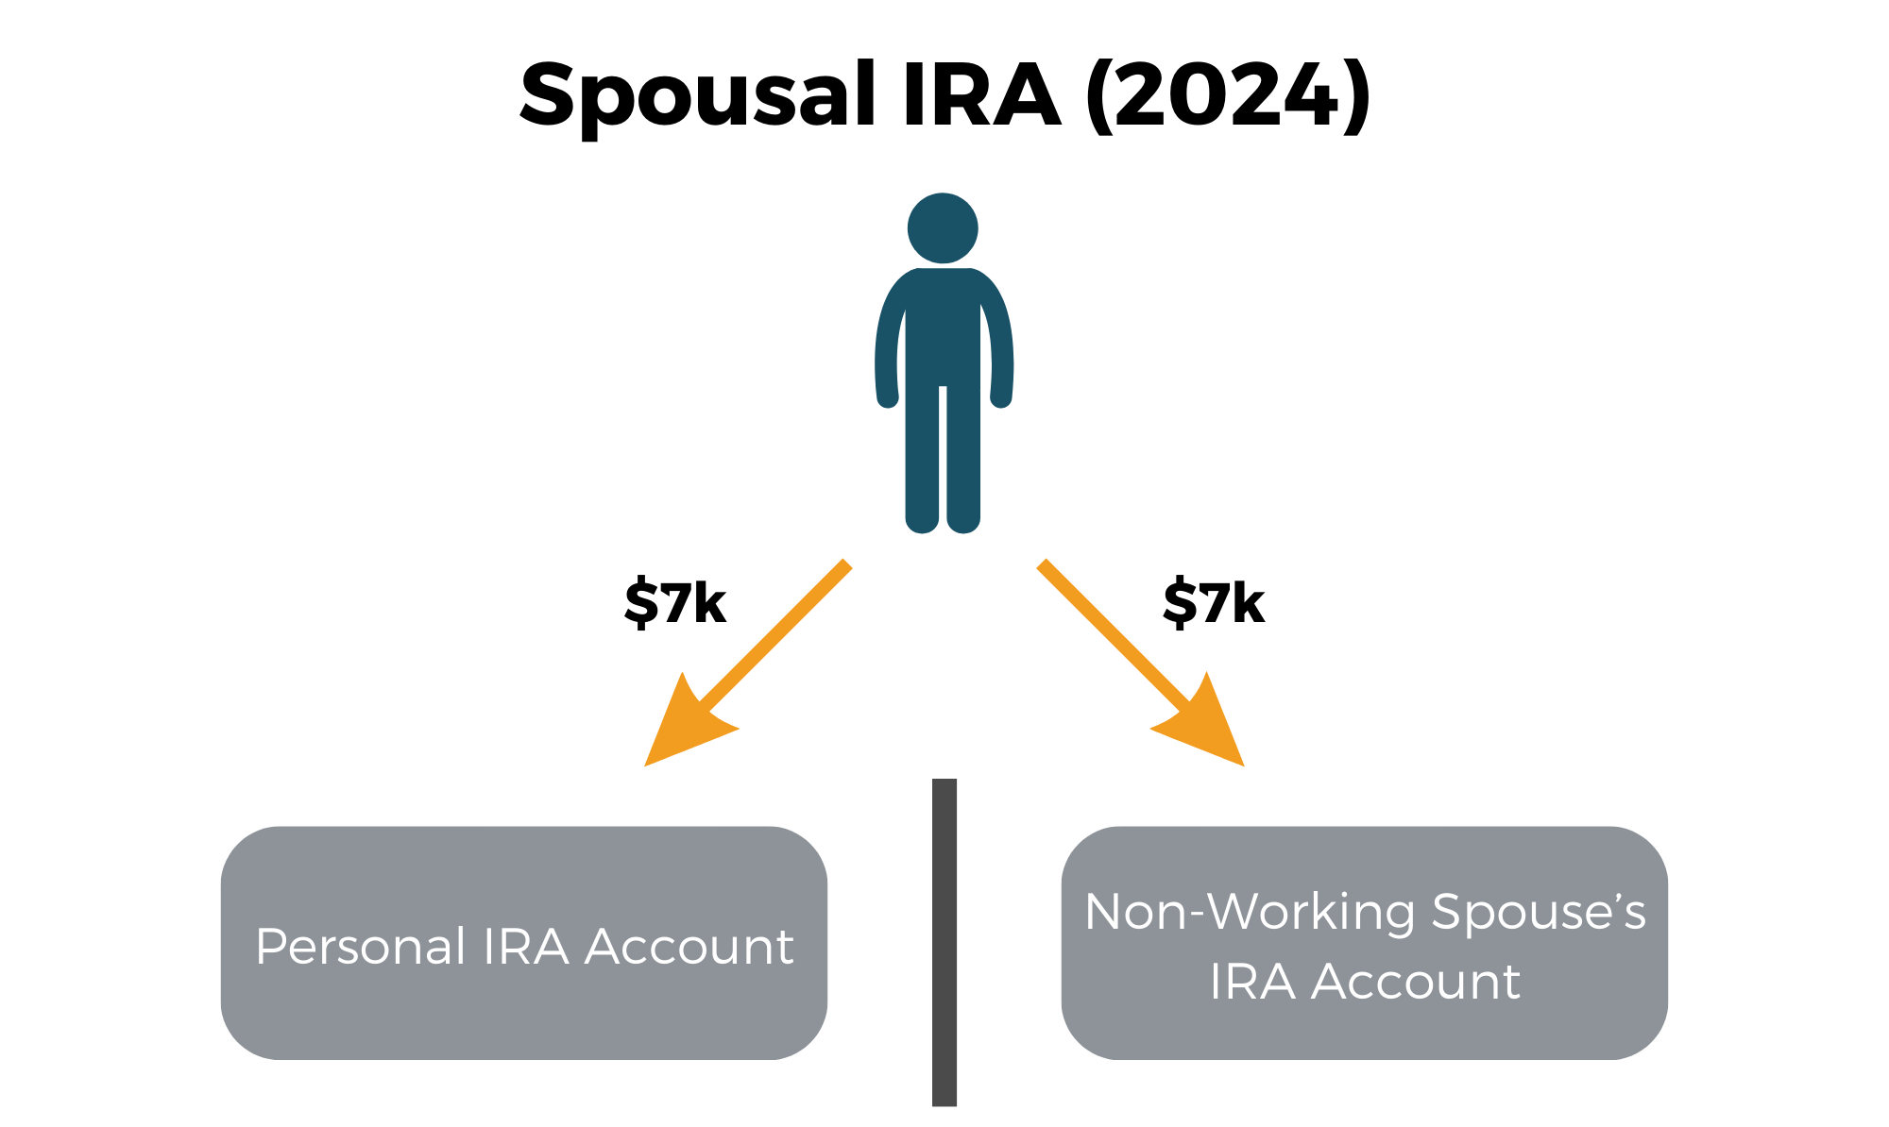
Spousal IRA/Roth IRA Contributions
A non-working spouse can make a traditional/Roth IRA contribution using the working spouse’s compensation.
Notes:
While some baby boomer couples retire at the same time, oftentimes, one spouse retires before the other. In such cases, you may be able to take advantage of spousal IRA and/or Roth IRA contributions. These are special contributions that allow a spouse with compensation to make a contribution to the traditional IRA or Roth IRA of a non-working spouse. In essence, the non-working spouse can use the working spouse’s compensation as their own.

Slide 9
Can $8,000 per Year Make a Meaningful Difference?
Note: This illustration is hypothetical and assumes contributions of $8,000 were made during the first 10 years, and that a 6% rate of return was earned in all years. This does not represent the performance of any investment product, and your results may vary.
Notes:
You might be asking yourself: can a $8,000 contribution really make a difference when it comes to my retirement? The answer is absolutely. Here’s a quick example... suppose you’re 55 years old now and you plan to retire in 10 years, at 65. The kids have flown the coop and you finally have a chance to focus on saving for your retirement, so you make a full $8,000 Roth IRA contribution annually until you retire. If, say, you earn 6% per year, then by the time you retire in 10 years you’d have more than $100,000.
But remember, you may need to plan on living until 90, 95 or longer. So, let’s say that that you leave the account alone and it continues to earn 6% per year. By the time you reach 85, even if you never put another dollar in after the first 10 years, you’d more than $350,000. Plus, since you made your contributions to a Roth IRA, that entire amount would be tax free. Still think “just” $8,000 a year can’t make a difference? And just think, if you’re married and you were able to make that $8,000 contribution to both your Roth IRA and your spouse’s Roth IRA, you’d have twice as much... tax free!

Slide 10
Taxation of Retirement Account Withdrawals (Non-Roth)
New for 2024
2024 Federal Income Tax Brackets*
Tax Bracket | Single | Married-Joint
10% | $0 - $11,600 | $0 - $23,200
12% | $11,601-$47,150 | $23,201 - $94,300
22% | $47,151 - $100,525 | $94,301 - $201,050
24% | $100,526 - $191,950 | $201,051 - $383,900
32% | $191,951 - $243,725 | $383,901 - $487,450
35% | $243,762 - $609,350 | $487,451 - $731,200
37% | $609,350+ | $731,200+
*Based on taxable income. Source: IRS
Notes:
Alright, getting money into your retirement accounts is only the first half of the story. Coming up with an efficient way of taking those funds out, and avoiding costly mistakes, is the other half. This is far easier said than done, particularly when it comes to your traditional IRAs, 401(k)s, 403(b)s and other pre-tax retirement accounts.
In general, withdrawals from these accounts are taxed at ordinary income rates, just like interest. Your withdrawals are added to your income and taxed at whatever tax bracket you happen to find yourself in. If your overall income is relatively low, you might have a low tax rate for your withdrawal. On the other hand, if your overall income is higher, your tax rate will be higher and more of your IRA withdrawal will end up in Uncle Sam’s hands. Here’s a quick look at the tax brackets for single and joint filers for 2024.

Slide 11
Top Income Tax Rates Throughout History
Notes:
One of the troubling aspects of IRA planning is that the tax rate on your future distributions is unknown. Even if you can project your income with relative confidence, there’s no guarantee that tax rates will remain the same. And while it’s hard to find someone who doesn’t think they pay too much in taxes now, the reality is that the top tax rates today are pretty low in a historical context. Take a look at this chart to see what I mean. When the income tax was first introduced in 1913, the top rate was only 7%, but within just a few years, the top rate had already skyrocketed to over 70%. After dropping back down to as low as 25% after World War I, the top rate jumped to 63% in 1932. From there, it wasn’t until more than 50 years had passed when, in 1987, the top tax rate finally dropped back below 50%, letting those in the top bracket keep more of their income than they were forced to give over to Uncle Sam.
Now, of course, not everyone pays that top rate. In fact, it’s only a very small percentage of taxpayers that do. That said, with our national debt at all-time highs, a budget that hasn’t been balanced in years and fiscal troubles for many of our entitlement programs like Social Security and Medicare, it’s possible that rates could go up across the board. That makes coming up with the right plan even more important.

Slide 12
Required Minimum Distributions (RMDs)
Required minimum distributions (RMDs) begin for IRAs once you turn 73 (or 75)*
Required minimum distributions (RMDs) begin for most plans once you turn 73 (or 75)*
Failure to take an RMD can result in up to a 25% penalty.
Reminder
SECURE Act 2.0 increased RMD starting age from 72 to 73 for those born between 1951-1959. Those born in 1960 and later will begin RMDs at age 75.
Notes:
Once you reach a certain age, the law requires that you begin to take what are known as “required minimum distributions,” or RMDs for short, from your traditional IRA. The same rules generally apply to employer-sponsored retirement plans, like 401(k)s, too. RMDs are simply the bare minimum you are required to take from your retirement account each year to satisfy the tax code’s rules.
The specific age when you must begin taking RMDs depends on when you were born. If you were 72 or older as of the end of 2022, you should already be taking RMDs for your IRAs. For those of you who were still younger than 72 at the end of 2022, you’ll have to start taking RMDs when you turn 73 or 75, depending on when you were born. As you can see here on the bottom of the screen, for those of you born from 1951 through 1959, you’ll start RMDs at age 73. And for those of you born in 1960 or later, you’ll start taking RMDs when you reach 75… unless Congress changes the rules again between now and then!
A final thought before we move on… remember that you can always take more, but if you fail to at least take the minimum amount, the IRS can actually hit you with a 25% – that’s five-zero-percent – penalty for any amount that you should have taken but didn’t.

Slide 13
Who Can Do a Roth IRA Conversion?
Anyone can convert their IRA (or other eligible retirement account) to a Roth IRA:
No age limits (high or low)
No income limits (high or low)
No requirement to be working
Notes:
Something else to keep in mind is that unlike Roth IRA contributions, there are no restrictions on who can make Roth IRA conversions. You can’t be too old. You can’t be too young. You can be working, or you can be retired. There’s no minimum amount of income you need or a maximum amount of income you can have. I think you see what I mean. If you want to convert you IRA to a Roth IRA, there’s nothing in the tax rules that will stop you from doing so.

Slide 14
Roth IRAs Have No Required Minimum Distributions
No required minimum distributions during your lifetime.
You decide when you want to take distributions.
Allows your account to grow uninterrupted, tax-free for life.
Can provide a tax-free inheritance to heirs.
Notes:
Another big benefit of the Roth IRA, and one that many retirees find attractive, is that Roth IRAs have no required minimum distributions during your lifetime. Remember all those RMD calculations and potential mistakes we talked about earlier? They’re not an issue if you have a Roth IRA. During your lifetime, you can take as much, or as little, as you want. You’re not forced to take anything at 73 if you don’t want to. That means your Roth IRA can continue to grow and compound tax-free for your heirs, which also makes it a very intriguing vehicle from an estate planning perspective.

Slide 15
Three Key Questions Before Converting
Hint: The answer to each should be yes!
1
Do you have a rough idea of the conversion’s impact on your tax bill?
2
Do you have a plan to pay the resulting taxes?
3
Do you have a reasonable expectation that the benefits of ”pre-paying” your taxes like this makes sense in your overall plan?
Notes:
So, with that in mind, it’s very important that you are sure you want to convert your Roth IRA before doing so. Here are three questions to ask yourself before converting:
Do you have a rough idea of the conversion’s impact on your tax bill?
Do you have a plan to pay the resulting taxes?
Do you have a reasonable expectation that the benefits of “pre-paying” your taxes like this makes sense in your overall plan?
The answer to all these questions should be yes!

Slide 16
Withdraw From an IRA to Delay Social Security?
Reports have shown that Social Security is often the cheapest annuity you can “buy.”
Price = Other assets used to delay Social Security
Annuity bought = Difference in monthly benefits by delaying Social Security
Social Security benefits are generally more tax-efficient than IRA withdrawals.
At least 15% of Social Security benefits you receive will be tax-free.
Notes:
But you have to eat in the meantime, right? That might require you to pull money from your IRA in the interim to help cover your current living expenses. Retirees sometimes opt not to do this because they say, “What if I die early? I’ll have spent my IRA money, which takes away from my heirs, and I’ll have gotten little to nothing for it. While that’s certainly something to consider, here are two reasons you may want to give that approach a second thought.
First, a 2012 report from the Center for Retirement Research at Boston College concluded that Social Security is one of the cheapest, if not the cheapest, annuity available. That might sound a little funny. After all, you don’t buy Social Security, right? In a way, though, you kind of do. If you use IRA money to hold off on claiming Social Security for, say, a year, that’s kind of the price you paid to get the higher benefit. If you compare that “price” and increased benefit to what you can get from commercial annuity providers, it’s almost always cheaper.
Another reason it can make sense to draw from your IRA in order to help delay claiming Social Security benefits is that Social Security benefits are generally more tax efficient than IRA withdrawals. Remember, when you take an IRA withdrawal, the entire amount is generally added to your income and taxed at whatever rate you happen to be at. In contrast, Social Security benefits may be anywhere from 15% tax free all the way up to 100% tax free. So, the key point for you here is that trading a dollar of IRA income on your tax return for a dollar of Social Security benefits will almost always leave you with a lower tax bill and more money to spend.

Slide 17
Social Security & Claiming Strategies
To claim at age 62, Full Retirement Age, 70, or any age in between?
Widows/Widower Benefits – Considering your spouse is vital when determining a claiming strategy.
Cost of Living Adjustments – Increases happen but are not predictable.
Taxes – Your benefits will likely be 85% taxable on the Federal level. California won’t tax your Social Security benefits, but other states might.
Windfall Elimination Provision – Will your pension reduce or eliminate your Social Security benefits?
Social Security Analyzer – Break Even Analysis and Claiming Strategy outline.
Notes:
Can claim any time between 62 and 70. Many think when they can retire depends on when they claim social security. Those are, for many people, two completely independent decisions.
- Any time between 62 and FRA means a reduction in benefits.
- At 70 one can claim their maximum benefit.
- It’s a big decision and we use a tool called Social Security Analyzer to talk this through with clients.
- Break even age.
Widows/Widowers benefits. At the death of the first spouse, Social Security will pay the higher of the two benefits. This is important when we are considering claiming strategies as a higher benefit while we are alive could mean a higher benefit for our spouse when we are gone.
Taxes: If your total income (including ½ of your Soc Sec benefit is under $25,000 single ($32,000 married), you pay no taxes on Social Security. If your total income (including ½ of Soc Sec is between $25,000 and $34,000 single ($32k to $44k married) 50% of your Soc Sec is taxed. Above $34k single/$44k married 85% of your Soc Sec is taxed.
- For most that means 85% is taxable.
- CA doesn’t tax Soc Sec but 13 states do, and laws can always change.
Windfall Elimination and Government Pension Offset

Slide 18
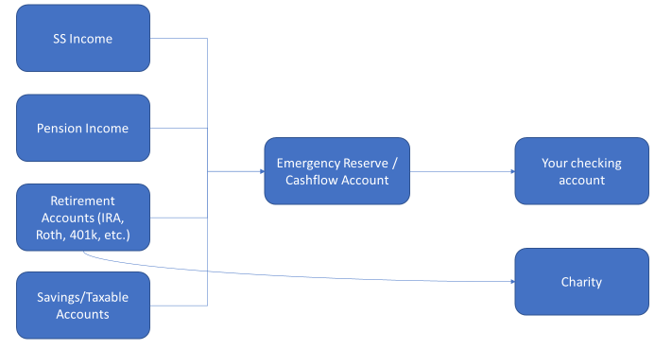
Recreating a Paycheck in Retirement
Notes:
The last thing we want to talk about is recreating your paycheck itself.
With all of these different income sources, it can be easy to get confused or mixed up with how to efficiently get the money into your checking account in time to pay all your bills.
That’s where Brio likes to step in with what we call Cash Flow Strategy
Essentially we funnel all of your income sources into one savings account, and then we send your checking account a bi-weekly or monthly distribution that’s in line with how much you can afford to spend. This is a lot easier for many people to handle because its what they’re used to from their working years as opposed to scattered income throughout the year.
We can also use this strategy to be smarter about your distributions from a tax angle. Not only can we can control which accounts we’re withdrawing from when, but we can also do more creative things like using some of your IRA distributions for Charity instead of from your cash accounts. Gene is going to touch a bit on this in just a minute. But generally, the smarter we can be with all of these distributions from all of these accounts, the lower we can keep your taxable income which is really important in retirement.
With that, I’ll hand it over to Gene to review taxes and Medicare.

Slide 19
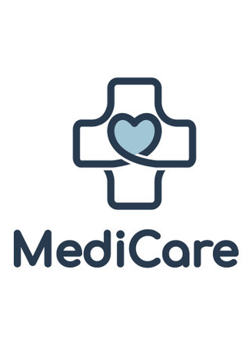
Taxes & Medicare
Income from Social Security, Pensions, Annuities, Traditional IRAs, 401(k)s and other retirement plans is taxable.
RMDs and Qualified Charitable Distributions.
Annuities – Distributions may be partially taxable.
Social Security – May be 0%, 50%, or 85% taxable.
Roth IRAs provide tax-free income.
Medicare Part B – Your premiums are based on your taxable income.
Let’s see how your income may impact your costs!
Notes:
Now I am going to turn it over to our Medicare Specialist, Pam Schmitz. She is going to talk us through how your income may impact your medicare premiums and important medicare timelines.

Slide 20
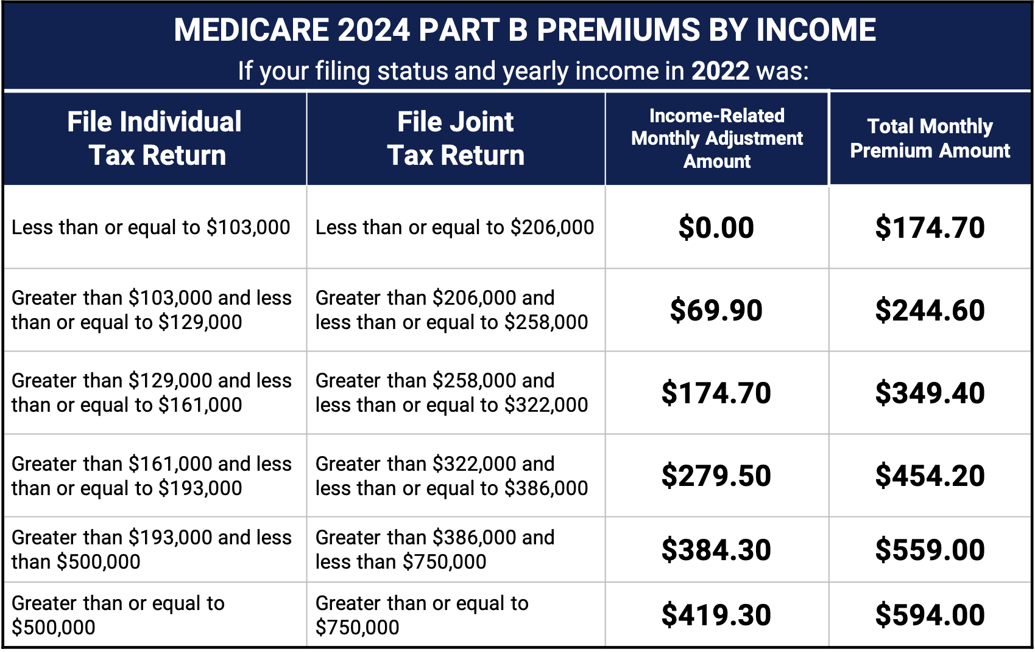
2023 Medicare Part B Premium Costs & IRMAA

Slide 21
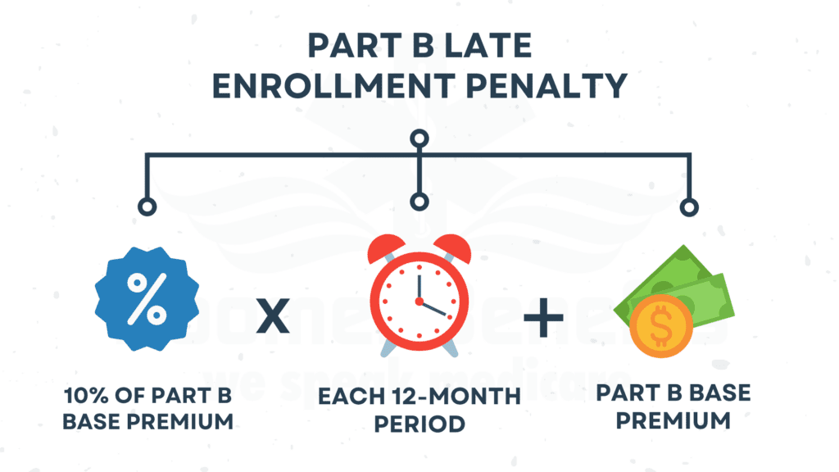
Medicare Penalties

Slide 22
Medicare Penalties
Medicare Penalties

Slide 23
Call to Action
Let your Brio Financial Group advisor quarterback your retirement income planning team.
Utilize a CPA to help with retirement income tax planning.
Send us your friends and family – those who are important to you are important to us!
Notes:
As we said earlier, this isn’t an exhaustive presentation to fully prepare you for retirement, but we do hope it has you asking the right questions about your own situation. We’d love to help answer any questions about your retirement income sources and help prepare you to feel comfortable about retiring.
If you have any tax questions and don’t already work with a CPA or tax advisor, we would love to connect you with a trusted resource in our network.
For anything Medicare related, our very own Pam Schmitz is an expert and would love to set up some time to go over your questions.
Lastly, we really hope that if this presentation had you thinking about friends or family who might not be making the right financial decisions, that you’ll connect us with them so that we can help.
With that, I want to say thank you again for your time today. We’ll go ahead and open it up for questions for the next 10-15 minutes.

Slide 24
This document is for information purposes only. Brio Consultants, LLC is an independent SEC-registered investment adviser. SEC registration does not constitute an endorsement by the SEC nor does it indicate a particular level of skill or ability. Brio Financial Group is an assumed business name of Brio Consultants, LLC. Neither the information nor the opinions expressed herein constitutes an offer or solicitation to buy or sell any investments or to make any investment decision. Please refer to the firm’s form ADV for more information. Past performance is no guarantee of future results, and political and economic risks may lead to significant losses, including complete loss, for investors. Advisory services are only offered to clients or prospective clients where Brio Financial Group and its representatives are properly licensed or exempt from licensure. Hypothetical returns do not factor the advisory fees charged by Brio Financial Group. Actual portfolio(s) may not resemble any of hypothetical allocation examples based on a variety of factors including but not limited to those listed above. Any distribution or copying of this communication is strictly prohibited. No offer to purchase or sell securities is being made in this communication. The information set forth herein was obtained from sources which we believe reliable, but we do not guarantee its accuracy. Overall account performance cannot and should not be extrapolated from any examples or illustrations given. This material is being provided for informational purposes only and nothing herein constitutes investment, legal, accounting or tax advice, or a recommendation to buy, sell, or hold a security. Neither the information nor the opinions expressed herein should be used to make any investment decision. Consultations with CPA’s or Estate Planning Attorneys regarding taxes and issues relating to estates or beneficiaries are recommended. Past performance is no guarantee of future results. For further information about this presentation, please contact us.
Different By Design®

